Slide 1

Cross-network Recommender Systems
Dilruk Perera

Slide 2

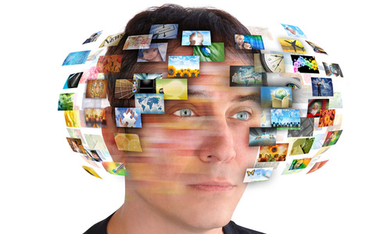




Motivation: Recommender Systems
  Overwhelming amounts of information are available on today’s Web
  Information overload problem
Solution: Recommender Systems (RSs)
    400 hours of videos uploaded per minute !
    270,000 snapchat stories are created per minute !
75% of interactions are based on a recommendation
35% of sales are initiated by a recommendation
Notes:
Goal: Develop user profiles and capture user interests.

Slide 3
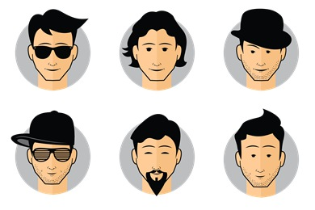





Motivation: Limitations of RSs
$$Items$$
Data sparsity issues
Results: Low recommender accuracy
Better approach: Use cross-network information
Existing user
1
0
0
0
1
0
1
0
0
0
1
0
$$Items$$
New user
0
0
0
0
0
0
0
0
0
0
0
0

Slide 4


Statistics
YouTube video recommendations using Twitter and Google+ auxiliary information
Accuracy :
Dilruk Perera and Roger Zimmermann, “Exploring the use of Time-Dependent Cross-Network Information for Personalized Recommendations,” 25th ACM International Conference on Multimedia, ACM, 2017
Dilruk Perera, and Roger Zimmermann, “LSTM Networks for Online Cross-Network Recommendations,” 2018 International Joint Conference on Artificial Intelligence, IJCAI, 2018
Source networks
Target network
Existing user
New user
Baseline
Novelty : 11% and Diversity : 38%
Only few updates (1-3 iterations) are sufficient during online operations

Slide 5



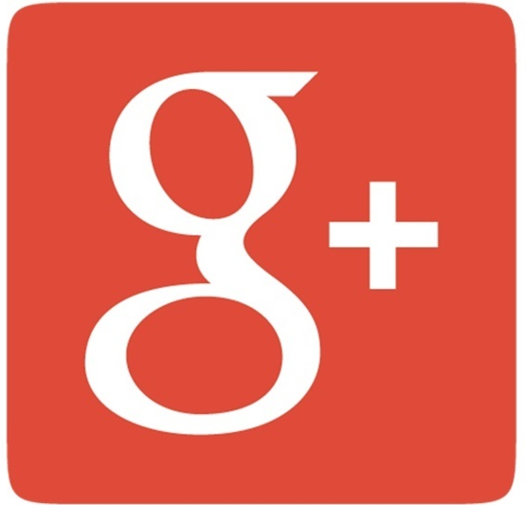


Data Challenge
All good to replace single network recommender systems using cross-network systems?
  Existing solutions require users to be fully overlapped across networks
  Remaining non-overlapped users (majority) are ignored
Overlapped user
Non-overlapped user
Notes:
So compared to single network RSs, cross-network RSs have better accuracy, novelty and diversity.
So, this gives the introduction to our next work, Can we some how come up with a solution to synthesize/generate those missing data?

Slide 6
CnGAN: Generative Adversarial Networks for Cross-network user preference generation for non-overlapped users
Generative adversarial approach to synthetically generate missing user preferences data on source networks
Dilruk Perera, and Roger Zimmermann, “CnGAN: Generative Adversarial Networks for Cross-network user preference generation for non-overlapped users,” Web Conference, WWW, 2019

Slide 7




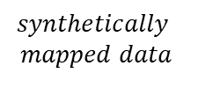
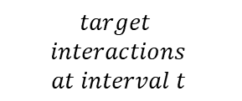




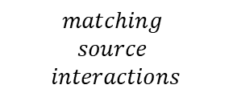




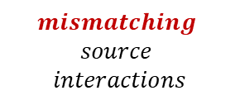
Adversarial generation process
$$mapping$$
$$unmapping$$
Adversarial training using 3 types of data:
$$Discriminator$$
$$mismatching$$
$data$
$$synthetically$$
$$mapped data$$
1. Matching data
$$matching$$
$data$
$$≪replicate≫$$
$$Generator$$
2. Synthetically mapped data
$${Enc}_{src}$$
$${Enc}_{src}$$
$${Enc}_{tgt}$$
3. Mismatching data
$$matching$$
$$source$$
$$interactions$$
$$target$$
$$interactions$$
$$at interval t$$
$$mismatching$$
$$source$$
$$interactions$$
Notes:
Once this is learned, for any given user in the target network, his interactions on source network can be generated

Slide 8








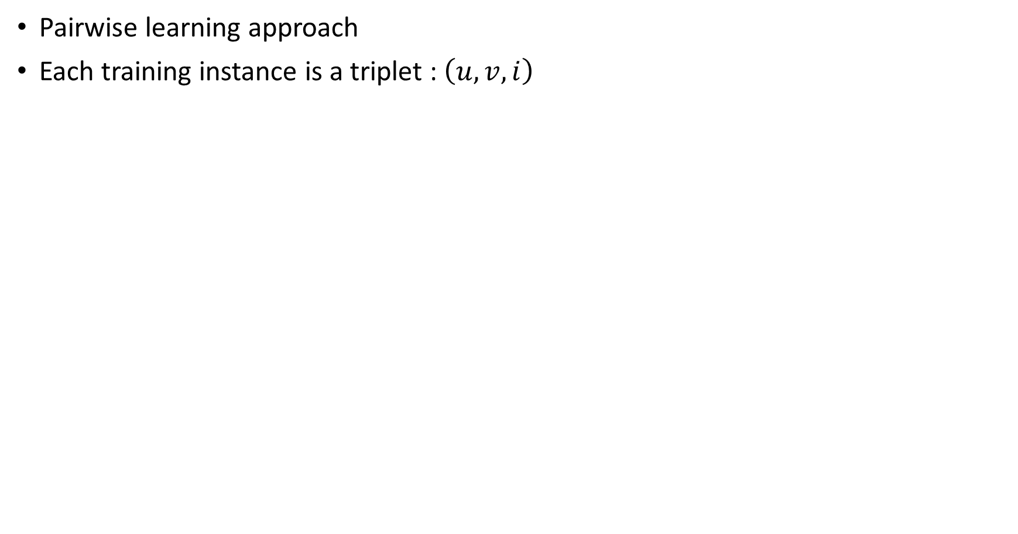




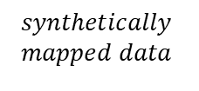




Recommendation
user $u$
user $v$
Pairwise learning approach
Each training instance is a triplet : $\left(u, v, i\right)$
item $i$
prediction
$${\hat{r}}_{ui}^{t}$$
$${\hat{r}}_{vi}^{t}$$
$$synthetically$$
$$mapped data$$
$$previous$$
$$interactions$$
$$user$$
$$representation$$
$$Neural Net$$
$${\hat{r}}_{ui}^{t}$$
$$G$$
0
…
1
$${\hat{r}}_{ui}^{t}− {\hat{r}}_{vi}^{t}$$
$$item i$$
…
0
$$maximize$$
$${\hat{r}}_{vi}^{t}$$
$$Neural Net$$
$$G$$

Slide 9

Multi Task Learning approach
Both Generator and Recommender tasks depend on each other
  Generated user preferences are used for recommendations
  Recommendation errors are used to learn the Generator
Both tasks are learned as an end-to-end process in a multi-task learning environment
Generator
Recommender

Slide 10
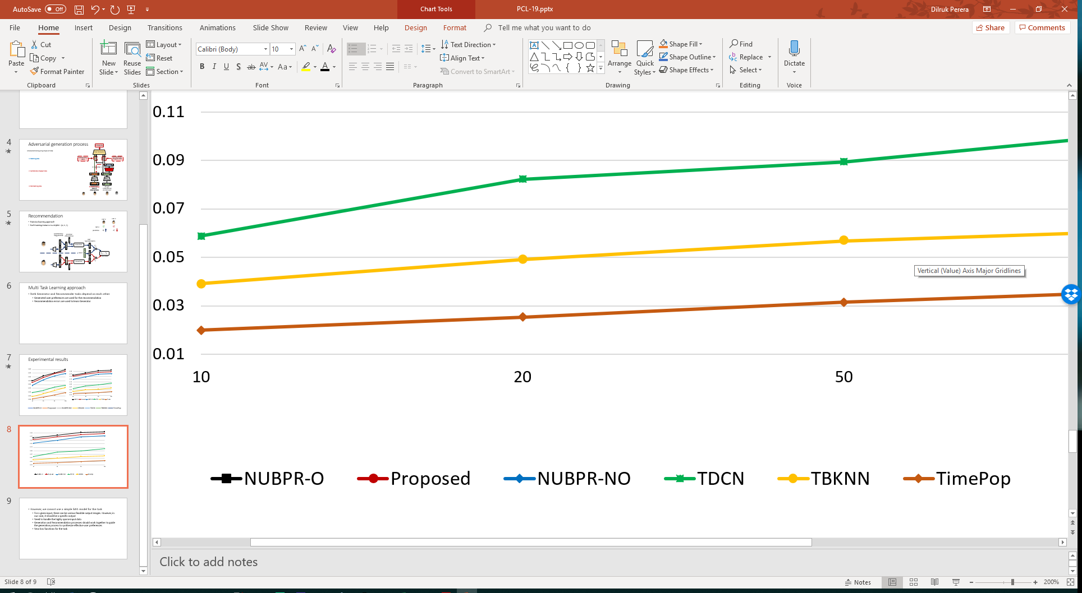
Experimental results
HR
NDCG
Top-N
Top-N
Fully overlapped data
Synthetically generated data
Target network data only

Slide 11
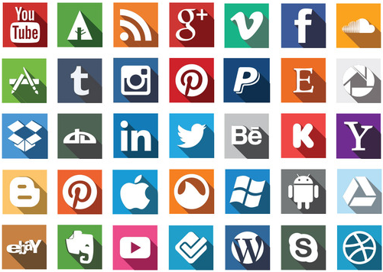
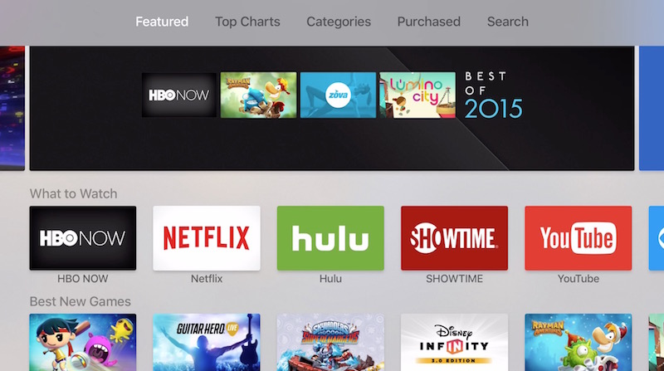
Develop one stop recommender platforms!!
https://www.macrumors.com/how-to/apple-tv-app-store/ http://www.heightensocial.com/blog/2016/1/8/7-easy-steps-to-add-social-media-icons-to-your-gmail-signature

Slide 12
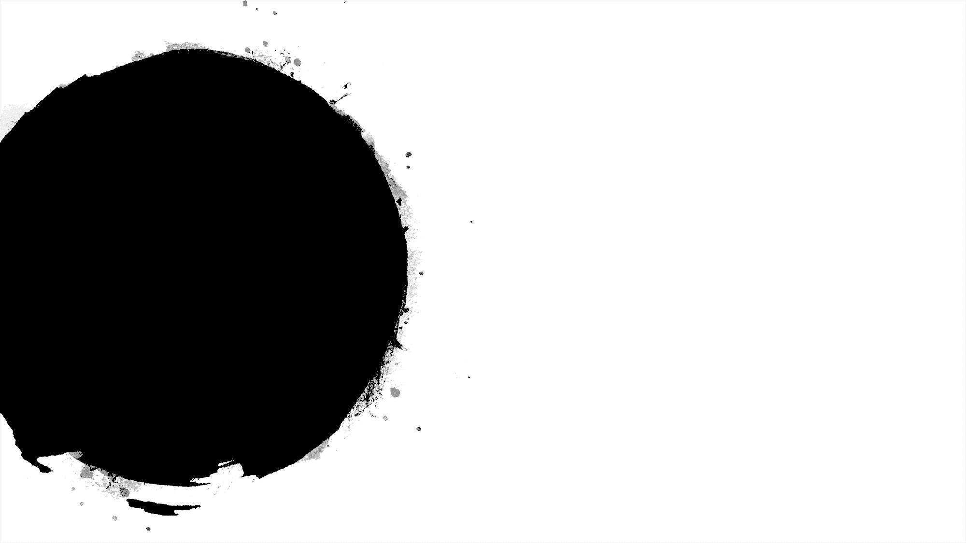

Publications:
Dilruk Perera, and Roger Zimmermann, “CnGAN: Generative Adversarial Networks for Cross-network user preference generation for non-overlapped users,” The Web Conference, WWW, 2019
Dilruk Perera, and Roger Zimmermann, “LSTM Networks for Online Cross-Network Recommendations,” 2018 International Joint Conference on Artificial Intelligence, IJCAI, 2018
Dilruk Perera and Roger Zimmermann, “Exploring the use of Time-Dependent Cross-Network Information for Personalized Recommendations,” 25th ACM International Conference on Multimedia, ACM, 2017

Slide 13
However, we cannot use a simple GAN model for the task
  For a given input, there can be various feasible output images. However, in our case, it should be a specific output
  Need to handle the highly sparse input data
  Generation and Recommendation processes should work together to guide the generation process to synthesize effective user preferences
  New loss functions for the task

Slide 14
Effectiveness
YouTube video recommendations using Twitter and Google+ auxiliary information
Source networks
Target network
Effectiveness
Accuracy :
Novelty : 11% and Diversity : 38%
Dilruk Perera and Roger Zimmermann, “Exploring the use of Time-Dependent Cross-Network Information for Personalized Recommendations,” 25th ACM International Conference on Multimedia ACM, 2017
Practicality
YouTube video recommendations using Twitter and Google+ auxiliary information
Dilruk Perera, and Roger Zimmermann, “LSTM Networks for Online Cross-Network Recommendations,” 2018 International Joint Conference on Artificial Intelligence, IJCAI, 2018
Existing user
New user
Baseline

Slide 15
Practicality
Online YouTube video recommendations using Twitter auxiliary information
Dilruk Perera, and Roger Zimmermann, “LSTM Networks for Online Cross-Network Recommendations,” 2018 International Joint Conference on Artificial Intelligence, IJCAI, 2018
Source networks
Target network

Slide 16
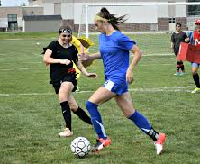



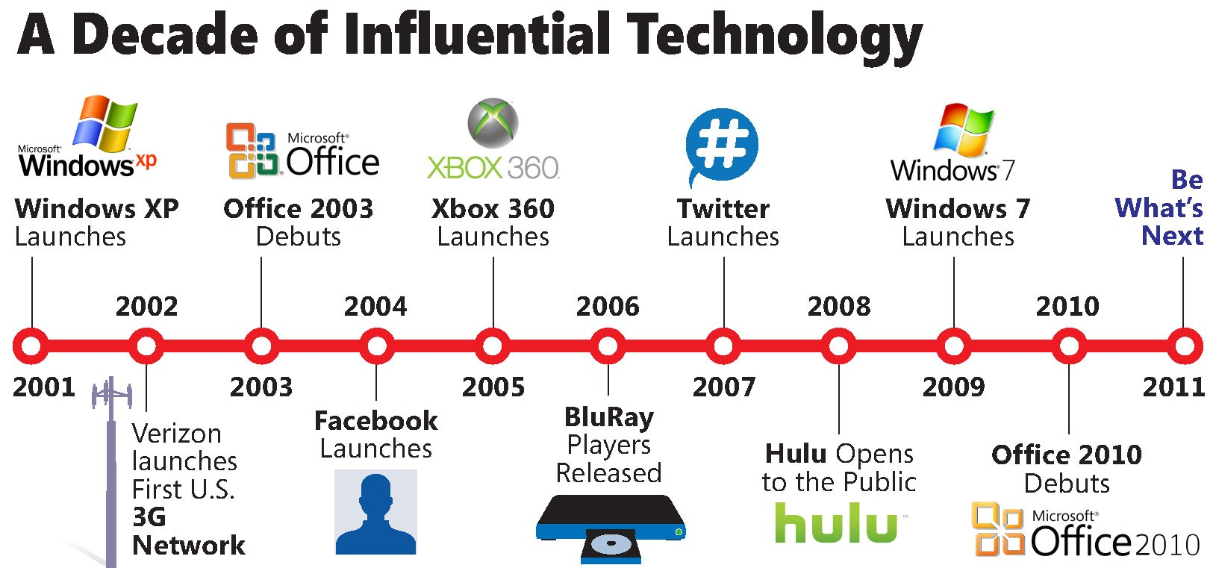


Motivation: limitations of existing solutions
Does not update user preferences based on incoming interactions
Unable to conduct recommendations for non-overlapped users
$$?$$
Notes:
Despite the growing interest in the area, we observed two main limitations in existing cross-network recommender solutions.
First, almost all available cross-network recommender systems use linear models. Such as linear factorization models. So, they are unable to capture underlying complex relationships in user data due to the linearity constraint.
Second, they are offline models, so when deployed, they cannot capture user preference dynamics and update the user preferences according to the incoming interactions. This is crucial for cross-network environments, because streams of interactions are coming in from many different networks and we need to understand the dynamics of each of the streams.
For example, when deployed, offline models cannot differentiate these two users. One can continue to watch football videos, and the other one only has a sudden interest towards the subject for a small period of time. So we should understand these dynamics and recommend accordingly. Otherwise the recommendations will be outdated.

Slide 17
Study 1 : Effectiveness
We propose :
  Unified (Existing user + New user)
  Time aware
  Cross-network, recommender solution
YouTube video recommendations using Twitter auxiliary information
Source network
Target network

Slide 18
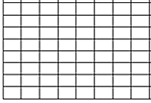











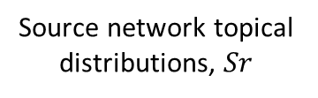







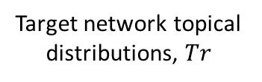

Overview
Source network interactions
Source network topical distributions, $Sr$
$$t_{1}$$
$$t_{n}$$
Topic Modeling
$$t_{2}$$
Source information transfer
…
…
$$t_{n}$$
$$t_{2}$$
User profiles for new users
$$t_{1}$$
$$t_{1}$$
Target information transfer and integration
$$t_{n}$$
Topic Modeling
$$t_{2}$$
…
…
$$t_{2}$$
$$t_{n}$$
User profiles for existing users
$$t_{1}$$
Target network topical distributions, $Tr$
Target network interactions

Slide 19
Experimental Results
Accuracy :
Novelty : 11% and Diversity : 38%
Dilruk Perera and Roger Zimmermann, “Exploring the use of Time-Dependent Cross-Network Information for Personalized Recommendations,” 25th ACM International Conference on Multimedia, ACM, 2017
Proposed
Baseline Cross-net
Proposed-new user
Single net

Slide 20
Journey
Study 1: Effectiveness
Study 2:
Practicality
Study 3:
Data Challenge

Slide 21
Study 2 : Effectiveness
We propose :
  LSTM based online Cross-network Recommender System
YouTube video recommendations using Twitter auxiliary information
Source networks
Target network

Slide 22
LSTM Networks for Online Cross-Network Recommendations
Dilruk Perera, and Roger Zimmermann, “LSTM Networks for Online Cross-Network Recommendations,” 2018 International Joint Conference on Artificial Intelligence, IJCAI, 2018

Slide 23




Model : LSTM
Models sequences as a chain of repeating modules (cells)
Each cell represents an instance of the sequence
Current prediction
LSTM Cell
Forget
gate
Input
gate
Output
gate
LSTM Cell
LSTM Cell
$$⋯$$
Current input
$$t_{n−1}$$
$$t_{n}$$
$$t_{n+1}$$
Notes:
To address both these issues in a single solution, we propose an LSTM networks-based solution.
The reason to use LSTM is quite clear.
It is based on a neural architecture, so it can model non-linear, complex relationships in user data.
Second, it contains a chain of repeating modules and can be easily used in an online setting to update the model parameters with the incoming interactions.
However, there are a few challenges in using a vanilla LSTM model in a recommender environment.
First, they are not designed to handle highly sparse data. So as we know in recommender systems we have to work with sparse inputs.
Second, the Cell state bottleneck issue. In theory, LSTM can model long term dependencies in input data. But LSTM try to encode the full user history in to fixed length vector to infer current preferences.
Third, LSTM assumes uniform time gaps between inputs and it does not differentiate the time gaps between the inputs. In recommender systems, we know that the time gaps between interactions are crucial as they convey important information. Say a small time gap may mean that there can be little user preference changes whereas a larger time gap may mean that there can be high preference changes.
So, to address these issues, we introduce three new components to the standard LSTM.
First, a higher-order interaction layer to alleviate the sparsity.
Second, an attention mechanism to handle the cell-state bottleneck issue.
Third, time aware gates to incorporate time gap information in to the LSTM.

Slide 24



LSTM limitations
  Unable to handle highly sparse data
  Unable to handle irregular time gaps
  Cell-state bottleneck
  A higher-order interaction layer
  Time aware gates
  An attention mechanism
Current prediction
LSTM Cell
Time aware forget gate
Time aware input gate
Attention
gate
Output
gate
Higher order interaction layer
Current input
$$t_{n−1}$$
$$t_{n}$$
$$t_{n+1}$$
Additional time information
Weighted attention from previous cell states

Slide 25
Results
Online update: 1-3 iterations are sufficient
Notes:
These are the experimental results against the baselines.
To check the accuracy, we used both Hit Ratio and NDCG metrics.
Proposed solution is the red line. Top three solutions are using deep neural architectures, and outperforms other architectures like linear factorization models, and simple popularity based recommender models.
Apart from the accuracy, we also wanted to check the performances of the diversity and novelty of the recommendations, and our model performed well.

Slide 26
Motivation: limitations of existing solutions
Unable to capture dynamics in the recommender environment
Unable to conduct recommendations for non-overlapped users
$$?$$
Notes:
Despite the growing interest in the area, we observed two main limitations in existing cross-network recommender solutions.
First, almost all available cross-network recommender systems use linear models. Such as linear factorization models. So, they are unable to capture underlying complex relationships in user data due to the linearity constraint.
Second, they are offline models, so when deployed, they cannot capture user preference dynamics and update the user preferences according to the incoming interactions. This is crucial for cross-network environments, because streams of interactions are coming in from many different networks and we need to understand the dynamics of each of the streams.
For example, when deployed, offline models cannot differentiate these two users. One can continue to watch football videos, and the other one only has a sudden interest towards the subject for a small period of time. So we should understand these dynamics and recommend accordingly. Otherwise the recommendations will be outdated.

Slide 27
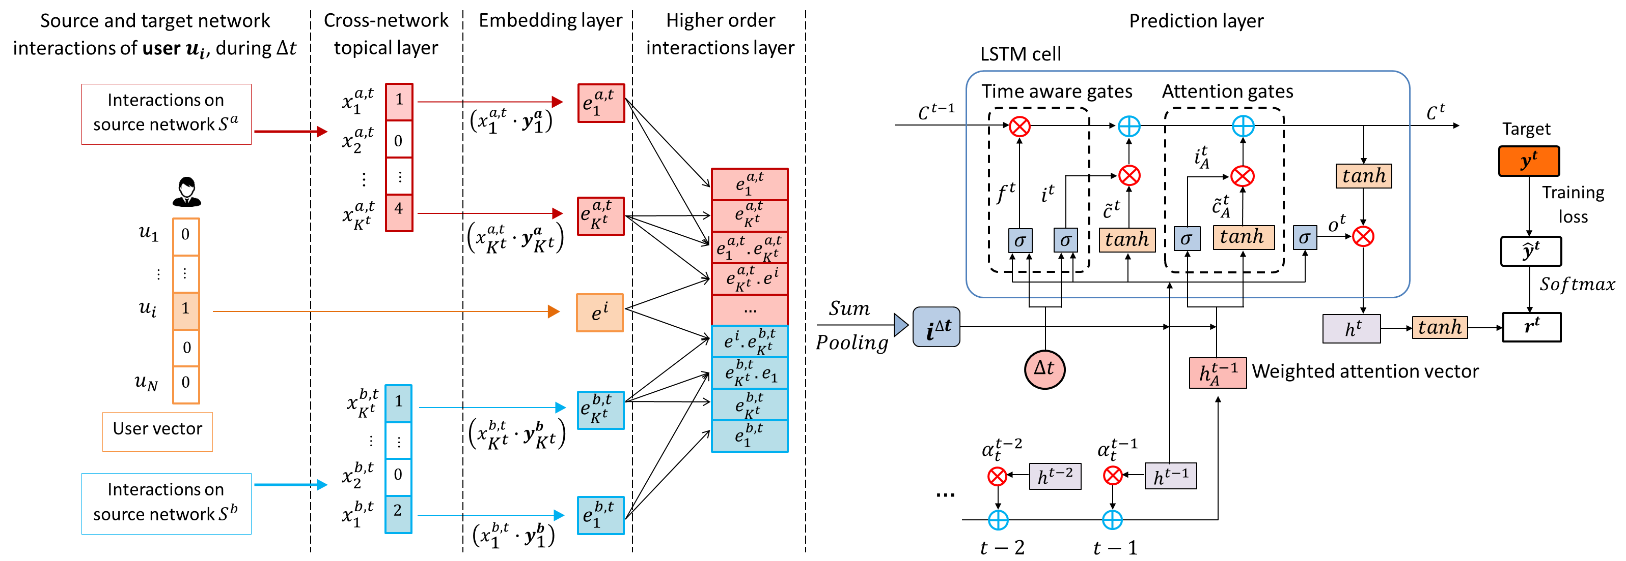

Slide 28






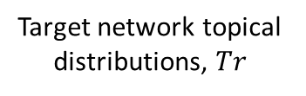
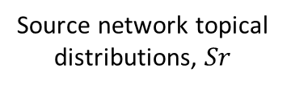







Source network user interactions
Source network topical distributions, $Sr$
$$t_{1}$$
Target network user profiles
$$t_{n}$$
Topic Modeling
$$t_{2}$$
Source information transfer
…
…
$$t_{2}$$
$$t_{n}$$
User profiles for new users
$$t_{1}$$
$$t_{1}$$
Target information transfer and integration
$$t_{n}$$
$$t_{2}$$
…
…
$$t_{2}$$
$$t_{n}$$
User profiles for existing users
$$t_{1}$$
Target network user interactions
Target network topical distributions, $Tr$

Slide 29
Source network interactions
Source network topical distributions, $Sr$
$$t_{1}$$
Target network user profiles
$$t_{n}$$
Topic Modeling
$$t_{2}$$
Source information transfer
…
…
$$t_{n}$$
$$t_{2}$$
User profiles for new users
$$t_{1}$$
$$t_{1}$$
Target information transfer and integration
$$t_{n}$$
Topic Modeling
$$t_{2}$$
…
…
$$t_{2}$$
$$t_{n}$$
User profiles for existing users
$$t_{1}$$
Target network topical distributions, $Tr$
Target network interactions

Slide 30
Journey & focus
Study 1: Effectiveness
Study 2:
Practicality
Study 3:
Data Challenge

Slide 31
Study 1 : Effectiveness
We propose :
  Unified (Existing user + New user)
  Time aware
  Cross-network, recommender solution
YouTube video recommendations using Twitter auxiliary information
Source network
Target network

Slide 32
Study 1: Effectiveness
YouTube recommender System using Twitter auxiliary data
new user and Existing user recommendations
Study 2: Practicality
  Online Cross-network Recommender Systems
  Extended vanilla LSTM to support recommendations

Slide 33
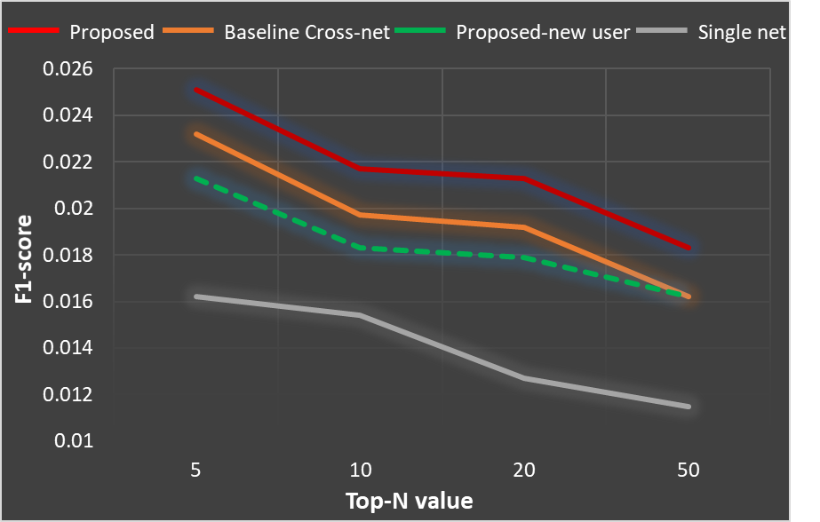






Study 1: Brief Overview
Accuracy :
Novelty : 11% and Diversity : 38%
Source network interactions
Source information transfer function
$$t_{n}$$
…
Recommendations for new users
$$t_{2}$$
$$t_{1}$$
Target information transfer and integration function
$$t_{n}$$
…
Recommendations for existing users
$$t_{2}$$
$$t_{1}$$
Target network interactions

Slide 34
Study 2 : Practicality
We propose :
  LSTM based online Cross-network Recommender System
YouTube video recommendations using Google+ and Twitter auxiliary information
Source networks
Target network

Slide 35
Model : LSTM
Models sequences as a chain of repeating modules (cells)
Each cell represents an instance of the sequence
Current prediction
LSTM Cell
Forget
gate
Input
gate
Output
gate
LSTM Cell
LSTM Cell
$$⋯$$
Current input
$$t_{n−1}$$
$$t_{n}$$
$$t_{n+1}$$
Notes:
To address both these issues in a single solution, we propose an LSTM networks-based solution.
The reason to use LSTM is quite clear.
It is based on a neural architecture, so it can model non-linear, complex relationships in user data.
Second, it contains a chain of repeating modules and can be easily used in an online setting to update the model parameters with the incoming interactions.
However, there are a few challenges in using a vanilla LSTM model in a recommender environment.
First, they are not designed to handle highly sparse data. So as we know in recommender systems we have to work with sparse inputs.
Second, the Cell state bottleneck issue. In theory, LSTM can model long term dependencies in input data. But LSTM try to encode the full user history in to fixed length vector to infer current preferences.
Third, LSTM assumes uniform time gaps between inputs and it does not differentiate the time gaps between the inputs. In recommender systems, we know that the time gaps between interactions are crucial as they convey important information. Say a small time gap may mean that there can be little user preference changes whereas a larger time gap may mean that there can be high preference changes.
So, to address these issues, we introduce three new components to the standard LSTM.
First, a higher-order interaction layer to alleviate the sparsity.
Second, an attention mechanism to handle the cell-state bottleneck issue.
Third, time aware gates to incorporate time gap information in to the LSTM.

Slide 36
LSTM limitations
  Unable to handle highly sparse data
  Unable to handle irregular time gaps
  Cell-state bottleneck
  A higher-order interaction layer
  Time aware gates
  An attention mechanism
Current prediction
LSTM Cell
Time aware forget gate
Time aware input gate
Attention
gate
Output
gate
Higher order interaction layer
Current input
$$t_{n−1}$$
$$t_{n}$$
$$t_{n+1}$$
Additional time information
Weighted attention from previous cell states

Slide 37
Results
Online update: 1-3 iterations are sufficient
Notes:
These are the experimental results against the baselines.
To check the accuracy, we used both Hit Ratio and NDCG metrics.
Proposed solution is the red line. Top three solutions are using deep neural architectures, and outperforms other architectures like linear factorization models, and simple popularity based recommender models.
Apart from the accuracy, we also wanted to check the performances of the diversity and novelty of the recommendations, and our model performed well.

Slide 38
Journey & focus
Study 1: Effectiveness
Study 2:
Practicality
Study 3:
Data Challenge

